Slide 1

Explainable AI (XAI)
Notes:
Schedule
5pm say hello
5:05 start
5:20 end main presentation, start demos but also answer questions
5:40 finish demos, get questions again, chill
5:50 end

Slide 2



Leon Zhu
Western AI
Director of Education
https://www.instagram.com/westernu.ai/

Slide 3
What’s Explainable AI?
It is a loosely applied title that applies to any endeavour or technique that improves transparency in Artificial Intelligence.
Part of the umbrella of Responsible AI, with accompanying implications.
Alternate name is Interpretable Machine Learning (IML) or XAI.
Notes:
Explainable AI is a brand ascribed to a field which is popular yet still very early stage.
Today we will only focus on the LLM portion of explainable AI.
We want to get from 100% hallucination (raw LLM) closer to 0% hallucination (something like google). Obviously we want to do this while still preserving the usefulness of generative outputs.
XAI is all about transparency. We want to learn more about how a model makes its decisions, or even its internal neural representations.
There is an alternative definition of XAI where it’s about achieving goals related to transparency. For example, preventing Claude Sonnet from giving instructions on hacking a bank can be XAI, even though it doesn’t deal with transparency per se, but rather safety.

Slide 4
Goals today
-Have a concrete fundamental understanding of XAI
-Understand a black-box example
-Understand a white-box example
-Think about what interpretability would look like in your own project
Notes:
Implementation feasibility really

Slide 5
Pitfalls
XAI is not a strict label.
It is still early, and will not be as straightforward as a mature field
It is a difficult field, and progress is often stalled
The more intelligent/bigger the model, the harder the interpretability
Notes:
XAI is a label that’s not universal. A lot of related work does not use this label, rather they focus on the specific mechanisms like attention mapping or hallucination. If you’re implementing a specific technique, it’s best to refer to that technique instead of XAI. Also, it gets confusing with Elon Musk’s xAI startup
Currently, it is arguable that XAI is mostly useless for production work outside of narrow contexts.
For example, GPT-4o cannot be made explainable. It’s just not possible. We can only do so for smaller models like a very very small version of GPT-4.

Slide 6
Pitfalls Pt 2.
“Historically, a common tactic in post-hoc works was convincing visualization of explanations that aligned with our intuitions (Olah et al., 2017; Yosinski et al., 2015; Nguyen et al., 2016). However, such visualizations are empty arguments, as humans can’t know what a true explanation looks like (Geirhos et al., 2023).” [Madsen et al., 2024]
Notes:
Sorry to be a bummer once again, but faithfulness is another challenge. Even if we get explanations, it’s still dangerous if that explanation does not align with what’s *actually* happening. To make matters more confusing, models such as GPT-4 are a Mixture of Experts, which means that even at temperature = 0, the output is nondeterministic. Small amounts of nondeterminism is not that big of a deal, but it does make it easier for these models to “runaway” in terms of explainability, if you will

Slide 7
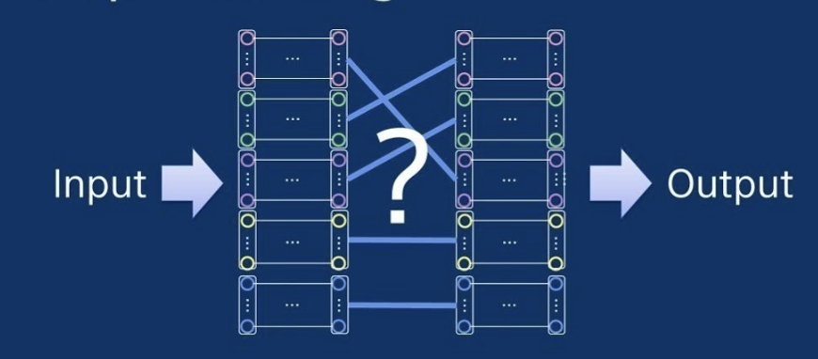
White box
White box methods engage with the inner workings (ie. attention weights) directly, which is tricky because LLMs are not (and can’t be) designed to allow for this efficiently.
This can be an ad-hoc method.
Notes:
Explainability is difficult because it works against the fundamental nature of computing. As we increase the complexity of a representation, say from an excel chart to a natural language representation, we are introducing a crazy amount of new functions and relationships. Each individual function is explainable, as seen with linear regression, but we cannot extrapolate easily to such a huge degree.
Even though white box is technically better, as it offers real time interpretability and certainty, unlike black box, it is currently less useful as it’s way less feasible.
LLMs which are purpose built for explainability do not fare well.

Slide 8
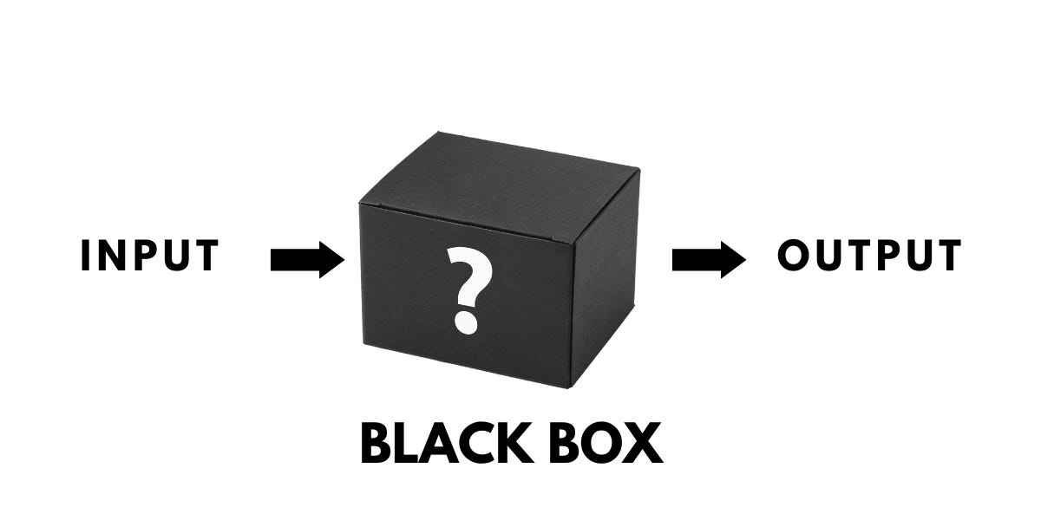
Black box
Black box methods are usually post-hoc strategies which focus on the input/output. This is currently the area of most progress and usefulness.
Notes:
Every machine learning learning model is interpretable to some degree through “universal” algorithms. When we say that LLMs are a black box, we refer to the difficulty of peering inside its neural representation. But we still have tools to test black boxes and we can isolate certain hypotheses.
The main tools to do so for Large Language Models is black box model-agnostic methods. Model-agnostic is helpful as we often don’t have access to the attention weights of closed-source models like Claude or GPT-4.
Even explainability in humans is black box. If you ask your accountant how they arrived at a calculation, that’s still black box, because you can’t 3d scan their brain to know what exactly their thought process was.
Unfortunately, these black box methods are typically limited to post-hoc analysis only. You would not be able to provide a live interpretation to the user. Not only do they have a high cost, due to multiple repeated API calls, but they depend on controlled experimental setups which would not be possible in a live setting.
But it makes sense that a less strict, more pragmatic approach would be better when the leading LLMs are growing so rapidly.

Slide 9
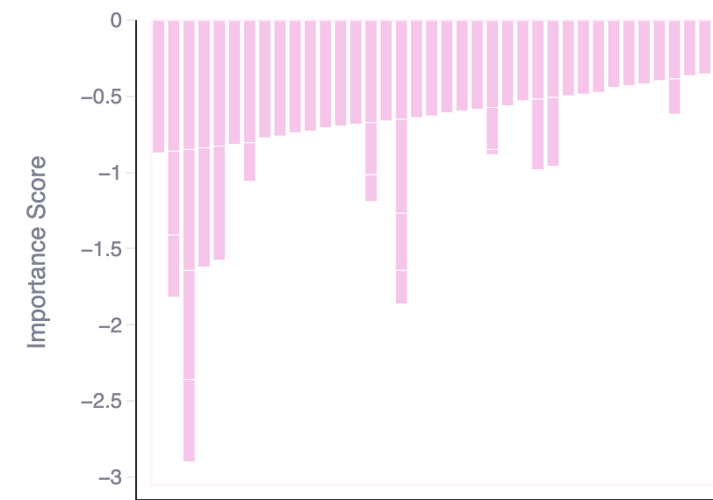
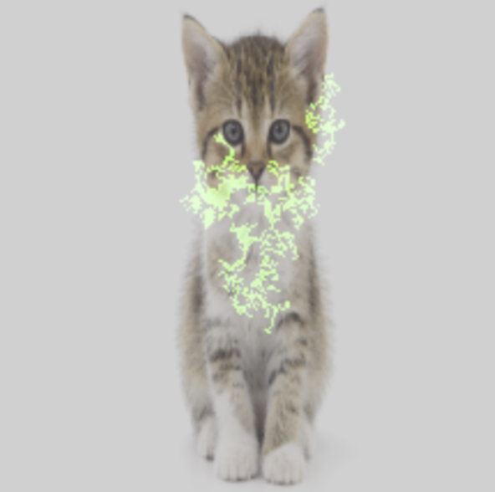
Black box: Feature Attribution
LLM example (cohere likelihood scores)
Featureinterp.replit.app
Image classification example
Google Vertex AI
Notes:
The cohere exampl

Slide 10
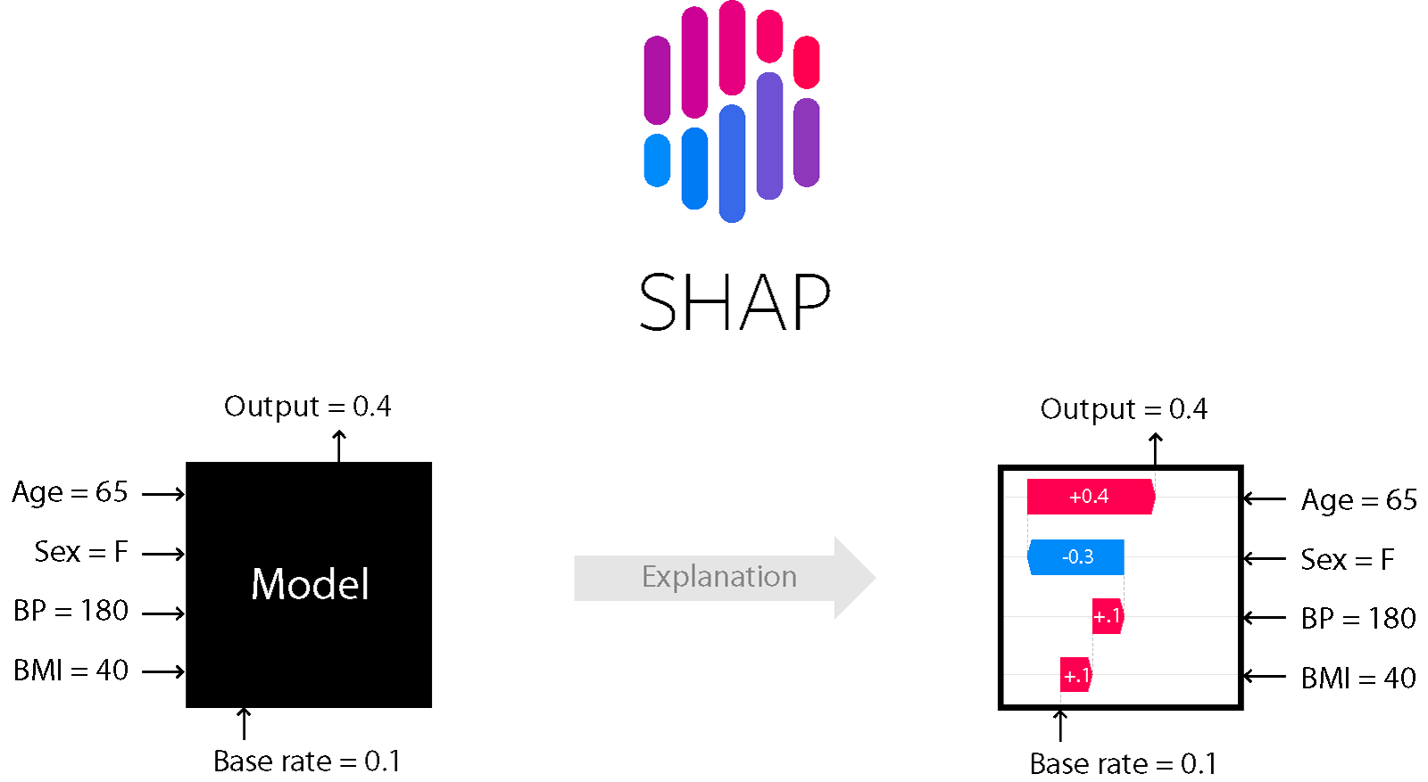
Black box: Shapley Additive Explanations (SHAP)
We perturb the input and use a SHAP library to calculate how much each token/feature contributes towards the input, called Shapley Values.
Notes:
The main model-agnostic tools we can use are such:
Shapley Additive Explanations. This involves perturbing the input and using the SHAP library to calculate the contribution of each token/feature towards the output.

Slide 11
Black box: Shapley Additive Explanations (SHAP)
SHAP great, because we get a global picture, while remaining a black box model (ie. almost always works).
Of course, the downside is that the amount of generations gets insane. OpenAI provides $15,000 of free API usage to any legal plaintiff, which is still not enough to truly see model behaviour.
Notes:
The main model-agnostic tools we can use are such:
Shapley Additive Explanations. This involves perturbing the input and using the SHAP library to calculate the contribution of each token/feature towards the output.

Slide 12
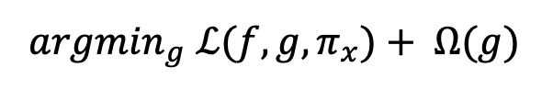
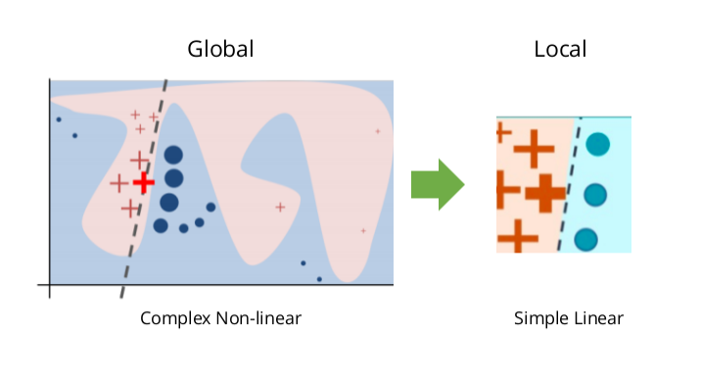
Black box: Local Interpretable Model-Agnostic Explanations
LIME essentially applies a linear regression model (which is perfectly explainable) onto a narrow area of the full model.
Notes:
LIME
Local interpretable model agnostic explanations is about shrinking a model into a local portion which can be modelled by linear regression.
Pros: this is perfectly explainable, as linear regression is the simplest model and designed to be fully explainable.
Cons: you’re only explaining the correlation, not the actual causation, since this is a black box model. As well, the local nature makes it less useful for diverse, complex use cases, such as a chatbot.
Components:
L(f,g,πx)L(f, g, \pi_x)L(f,g,πx​):
Represents the local fidelity loss, which measures how well the interpretable model ggg (e.g., linear regression) approximates the predictions of the black-box model fff within the local neighborhood of the instance xxx.
The term πx\pi_xπx​ refers to the weighting function that defines the "locality" of the instance xxx. Nearby instances (in terms of similarity to xxx) are weighted higher.
Ω(g)\Omega(g)Ω(g):
Represents a complexity penalty for the interpretable model g. The goal is to keep ggg simple and easy to understand, often by penalizing the number of features or the size of the coefficients.
arg⁡min⁡g\arg\min_gargming​:
Indicates that the process seeks the interpretable model g that minimizes the combination of the local fidelity loss and the complexity penalty.
Explanation:
The goal of this optimization is to find a balance between:
Ensuring that the interpretable model ggg provides a good approximation of the original model fff near the instance of interest.
Keeping ggg simple enough to be easily understood by humans.
How LIME Works
Generate Perturbations:
LIME creates variations of the input instance by randomly sampling from the input space.
Compute Predictions:
These perturbations are fed into the black-box model fff to get predictions.
Weight Perturbations:
Each perturbation is weighted based on its similarity to the original instance using πx\pi_xπx​, which could be a kernel function like an exponential kernel.
Fit Interpretable Model:
A simple, interpretable model ggg (e.g., linear regression) is trained on the perturbations and their corresponding predictions from fff, weighted by πx\pi_xπx​.
Explain Prediction:
The coefficients of ggg are used to provide an explanation of the black-box model's prediction for the specific instance.

Slide 13
White box
White-box is a white elephant. Good progress in attention attribution is being made, but ultimately it is very difficult.
Ecco is a project that attempts to explain generations (both causal and masked).
Notes:
White box is a white elephant because it promises the best explainability, but is essentially impossible to implement on a holistic level using current technology.

Slide 14

White box
Ecco Demo!
https://tinyurl.com/43fy5vh2
This Colab notebook is a fun example of whitebox neuron capturing

Slide 15
Prompt Engineering
This is the go-to for a basic implementation of many AI strategies. Unfortunately, it does not work too well for XAI.
Imagine testing a software programming via logging statements. It’s very helpful, but does not tell you more than what you already know, and does not react to differing inputs
Notes:
ANd of course just as final clarification, explainability does not mean that the model explains its actions. Explainability is providing transparency into its behaviour either through looking into its brain (white-box) or input/output perturbation

Slide 16
Conclusion
XAI not strictly necessary
Explainability-performance tradeoff
Users don’t really care
Classical techniques are the real champions
Legitimate explainability and genuine involvement
Notes:
Unlike other areas of AI like Reinforcement Learning, XAI is not strictly necessary. The “explainability-performance” tradeoff is not stopping, and users are generally content with explainability as long as the output is still human-consumable (e.g. javascript code).
However, this is where the loose definition of XAI comes handy. Classical ML techniques like clustering, KNNs, and linear regression are the real champions of XAI. They allow for legitimate and foolproof explainability while having genuine reasons to be involved in large language models.

Slide 17
Papers
https://arxiv.org/abs/2403.09863
https://www.sciencedirect.com/science/article/pii/S1566253523001148
https://arxiv.org/abs/2402.01761
https://arxiv.org/abs/2405.05386 Madsen Et al.
Notes:
The main model-agnostic tools we can use are such:
Shapley Additive Explanations. This involves perturbing the input and using the SHAP library to calculate the contribution of each token/feature towards the output.

